Slide 1
PROJECT – PECUNIA (Banking System)
Presented By - Ayush Soni

Slide 2
TEAM - F
Team Members –
Ayush Soni
Aditya Khatavkar
Akshay Tople
Aishwarya Sarna
Samanway Sahoo

Slide 3
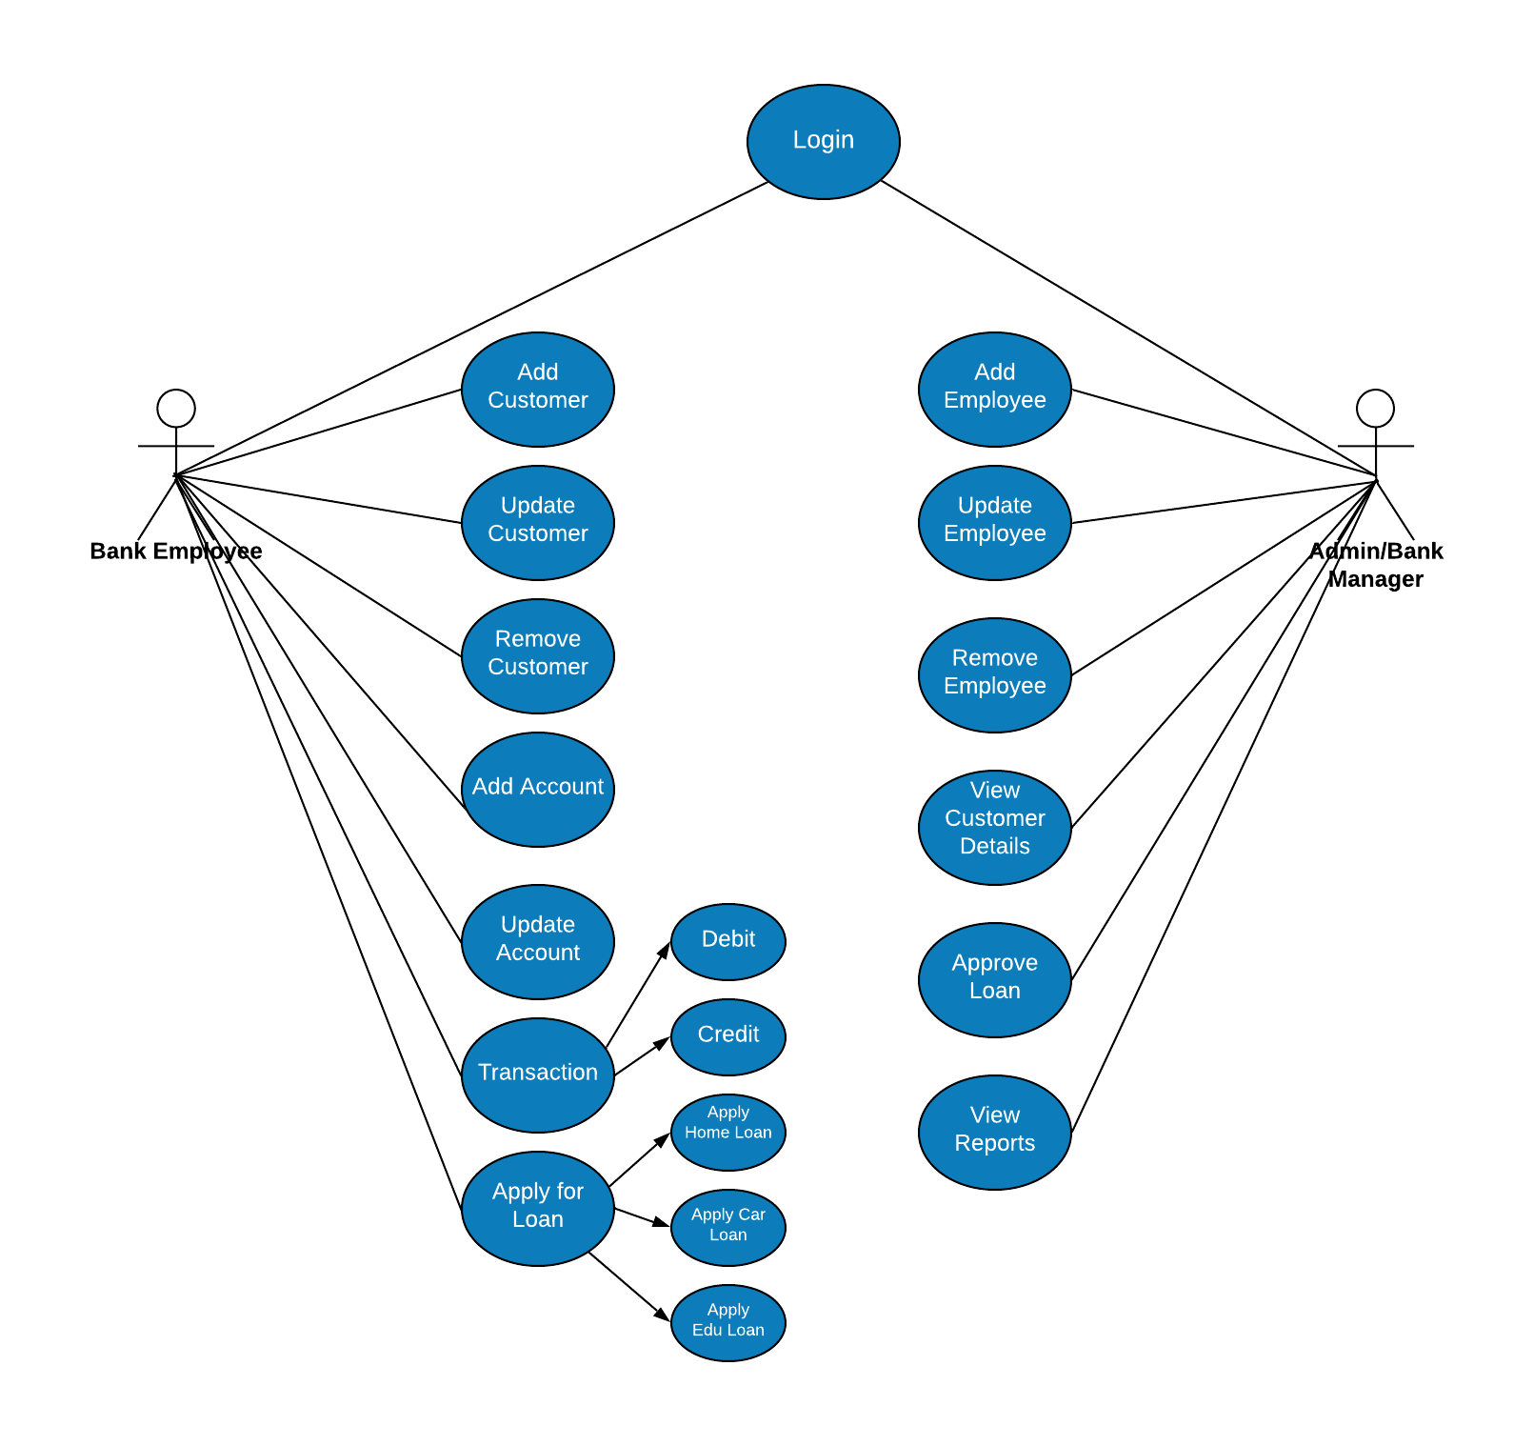
USE CASE DIAGRAM

Slide 4
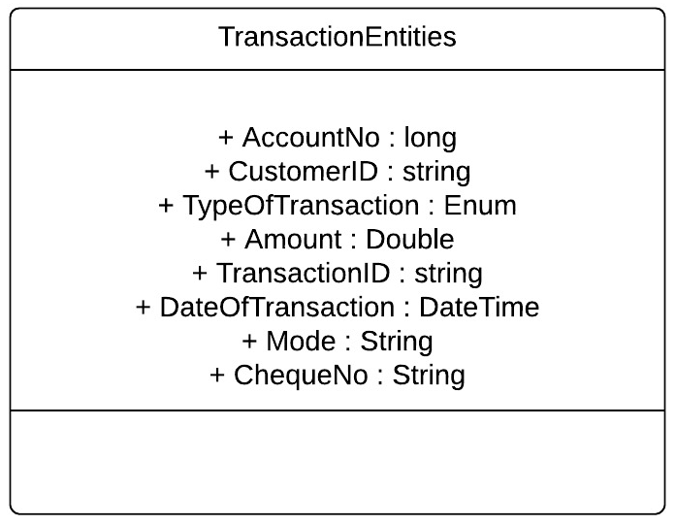
Class Diagram: TransactionEntities

Slide 5
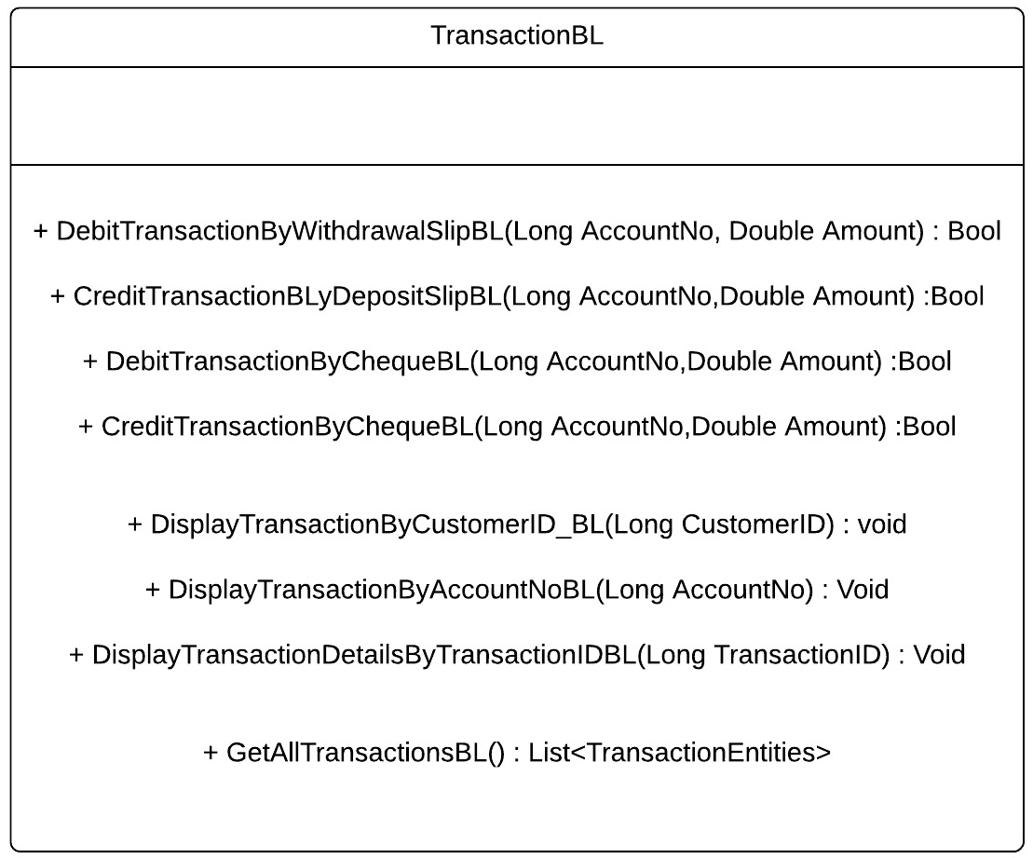
Class Diagram: TransactionBL

Slide 6
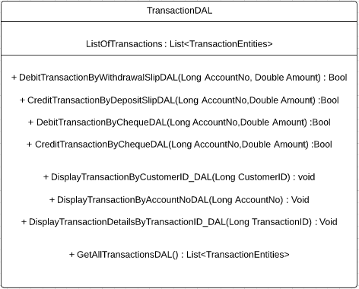
Class Diagram TransactionDAL

Slide 7
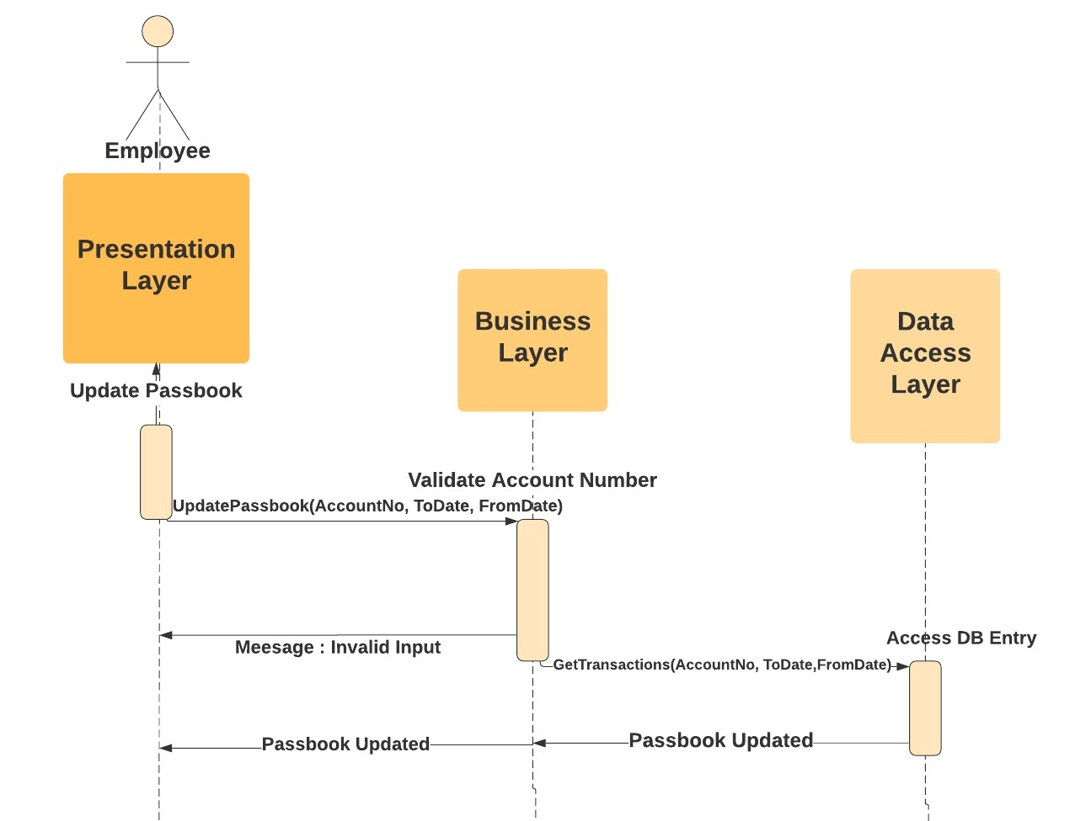
SEQUENCE DIAGRAM: Passbook Update
a) ​As a bank employee I want to be able to Update Passbook or print Transactions so that:
All transactions are printed correctly, in chronological order.

Slide 8
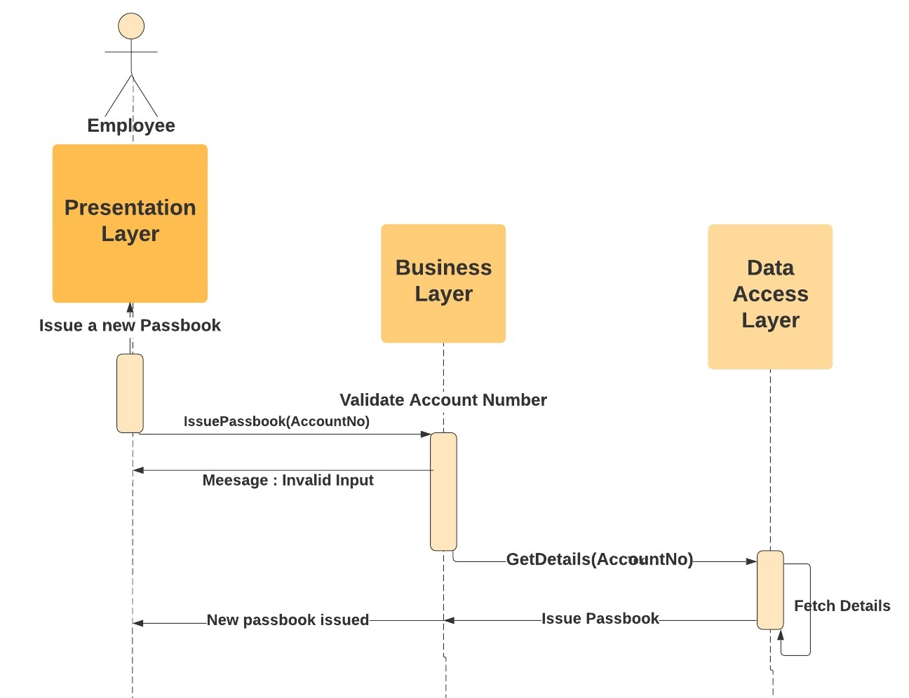
SEQUENCE DIAGRAM: Issue Passbook
b)​As a bank employee I want to be able to Issue new Passbook, so that:
There is, at max, 10 mins delay.

Slide 9
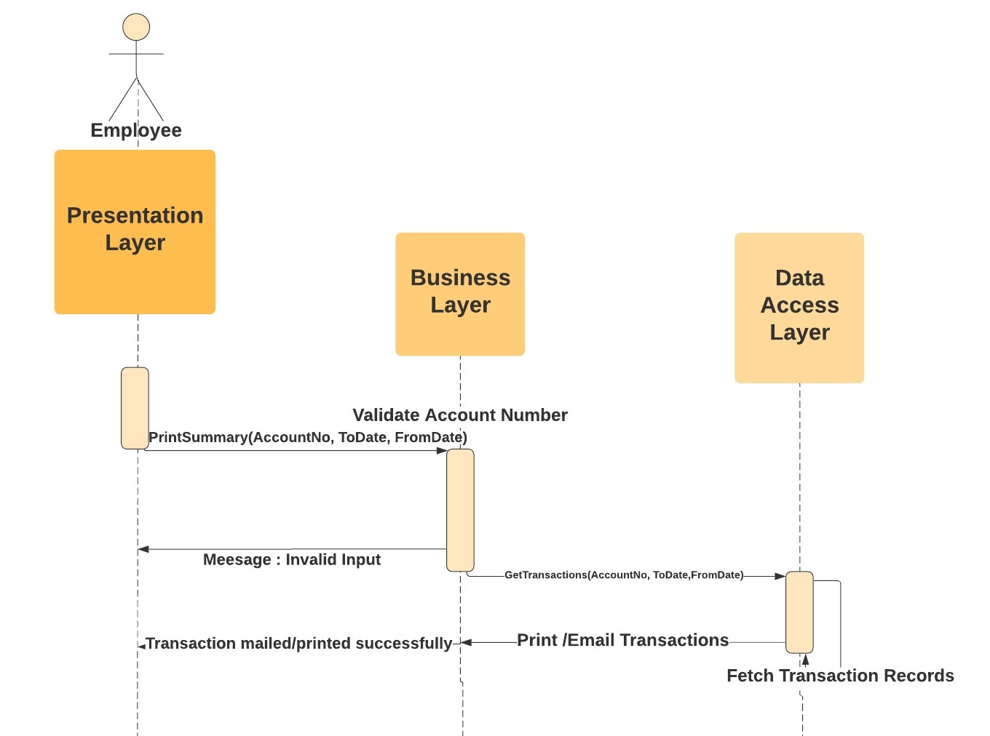
SEQUENCE DIAGRAM: Print/Email Summary
c)​As a bank employee I want to be able to Print/Email Account Summary, so that:
1) All transactions are printed briefly, correctly and in chronological order.

Slide 10
THANK YOU

